Slide 1


UNIVERSITY INSTITUTE OF ENGINEERING
COMPUTER SCIENCE & ENGINEERING
Introduction to Information Security and Cryptography
(Subject Code:20CST-354/ITT-354)
Prepared By : Er. Puneet kaur(E6913)
INTRODUCTION
DISCOVER . LEARN . EMPOWER

Slide 2

MAC and SHA
www. cuchd.in Campus : Gharaun, Mohali

Slide 3
Message Authentication Code (MAC)
MAC algorithm is a symmetric key cryptographic technique to provide message authentication.
For establishing MAC process, the sender and receiver share a symmetric key K.
Essentially, a MAC is an encrypted checksum generated on the underlying message that is sent along with a message to ensure message authentication.
The process of using MAC for authentication is depicted in the following illustration −

Slide 4
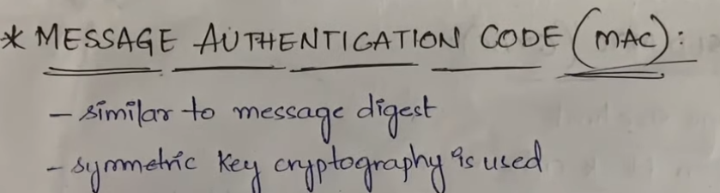

Slide 5
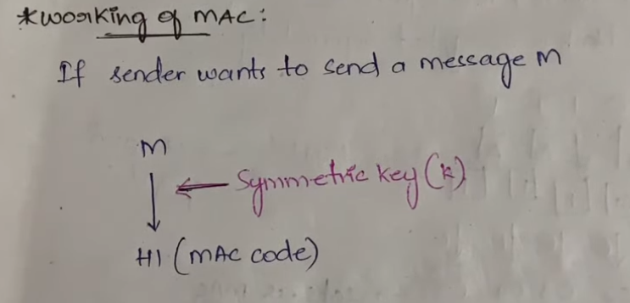

Slide 6
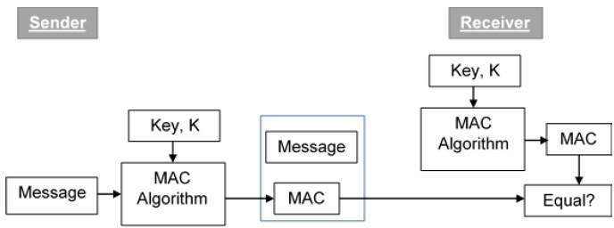
Message Authentication Code (MAC)

Slide 7
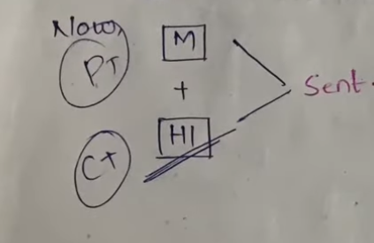

Slide 8
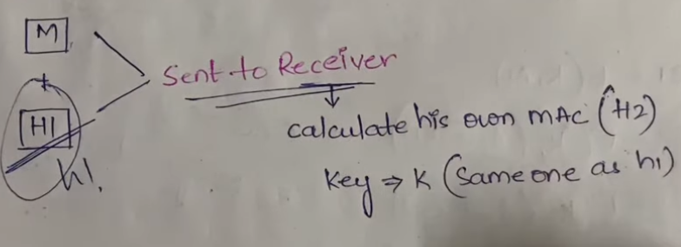

Slide 9
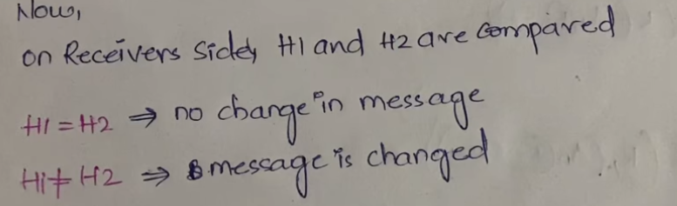

Slide 10
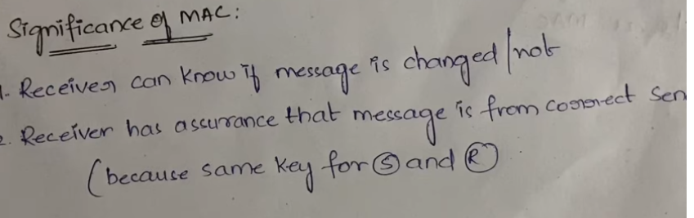

Slide 11
Message Authentication Code (MAC)
Let us now try to understand the entire process in detail −
The sender uses some publicly known MAC algorithm, inputs the message and the secret key K and produces a MAC value.
Similar to hash, MAC function also compresses an arbitrary long input into a fixed length output. The major difference between hash and MAC is that MAC uses secret key during the compression.
The sender forwards the message along with the MAC. Here, we assume that the message is sent in the clear, as we are concerned of providing message origin authentication, not confidentiality. If confidentiality is required then the message needs encryption.

Slide 12
Limitations of MAC
Establishment of Shared Secret.
It can provide message authentication among pre-decided legitimate users who have shared key.
This requires establishment of shared secret prior to use of MAC.
Inability to Provide Non-Repudiation
Non-repudiation is the assurance that a message originator cannot deny any previously sent messages and commitments or actions.
MAC technique does not provide a non-repudiation service. If the sender and receiver get involved in a dispute over message origination, MACs cannot provide a proof that a message was indeed sent by the sender.
Though no third party can compute the MAC, still sender could deny having sent the message and claim that the receiver forged it, as it is impossible to determine which of the two parties computed the MAC.

Slide 13
Limitation of MAC
Both these limitations can be overcome by using the public key based digital signatures discussed in following section.
Digital signatures are the public-key primitives of message authentication. In the physical world, it is common to use handwritten signatures on handwritten or typed messages. They are used to bind signatory to the message.
Similarly, a digital signature is a technique that binds a person/entity to the digital data. This binding can be independently verified by receiver as well as any third party.
Digital signature is a cryptographic value that is calculated from the data and a secret key known only by the signer.

Slide 14
Security Requirement of Hash Function
Variable input size
H can be applied to a block of data of any size.
2. Fixed output size
H produces a fixed-length output.
Efficiency
H(x) is relatively easy to compute for any given x, making both hardware and software implementations practical.

Slide 15
Security Requirement of Hash Function
Pre-image
For a hash value h = H(x), we say that x is the pre-image of h.
x is a data block whose hash function, using the function H, is h.
H is a many-to-one mapping
For any given hash value h, there will in general be multiple preimages.

Slide 16
Security Requirement of Hash Function
Pre-image resistant (one-way property)
For any given hash value h, it is computationally infeasible to find y such that H(y) = h.
5. Second pre-image resistant (weak collision resistant)
For any given block x, it is computationally infeasible to find y ≠ x with H(y) = H(x).
Guarantees that it is impossible to find an alternative message with the same hash value as a given message.

Slide 17
Security Requirement of Hash Function
Collision resistant (strong collision resistant)
It is computationally infeasible to find any pair (x, y) such that H(x) = H(y).
A hash function that satisfies the first five properties is referred to as a weak hash function.
If the sixth property, collision resistant, is also satisfied, then it is referred to as a strong hash function.

Slide 18
Security Requirement of Hash Function
7. Pseudorandomness
Output of H meets standard tests for pseudorandomness.
What is pseudorandomness?
The principle requirement for this capability is that the generated number stream be unpredictable.

Slide 19
Secure Hash Algorithm
Most widely used hash function.
Developed by the National Institute of Standards and Technology (NIST).
SHA is based on the hash function MD4.
Different version enhanced capabilities of SHA.
Under Discussion -> SHA-512

Slide 20
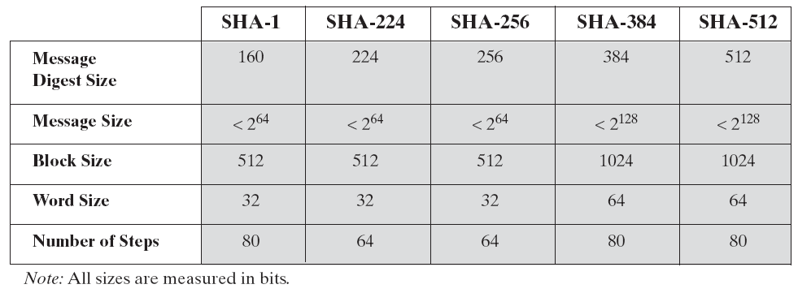
Secure Hash Algorithm
Comparison of SHA Versions

Slide 21
E- Books Recommended
https://www.pdfdrive.com/cyber-security-books.html
https://bookauthority.org/books/new-cyber-security-ebooks
https://bookauthority.org/books/best-cyber-security-ebooks
https://www.freetechbooks.com/information-security-f52.html

